Slide 1


DDD and FP Can’t Be Friends, Yet
Mike Sperber Henning Schwentner

Slide 2

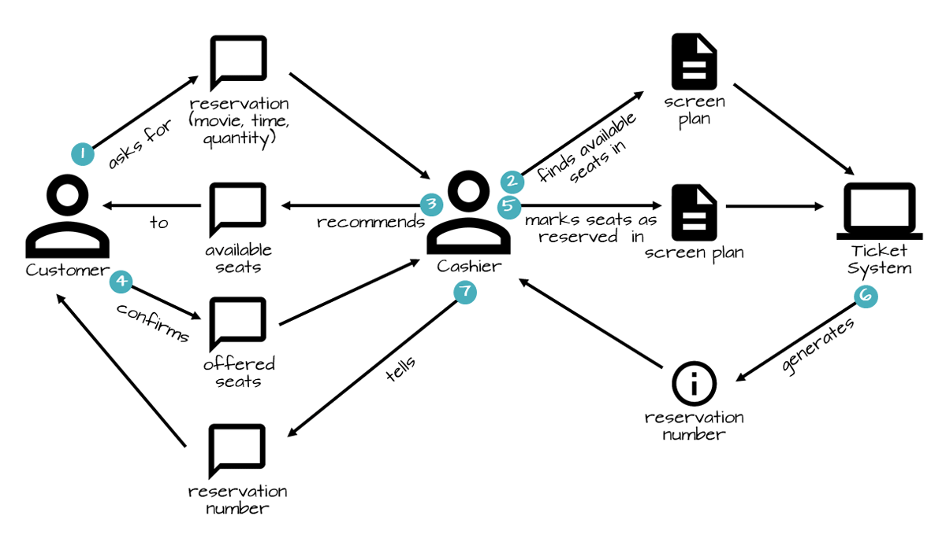

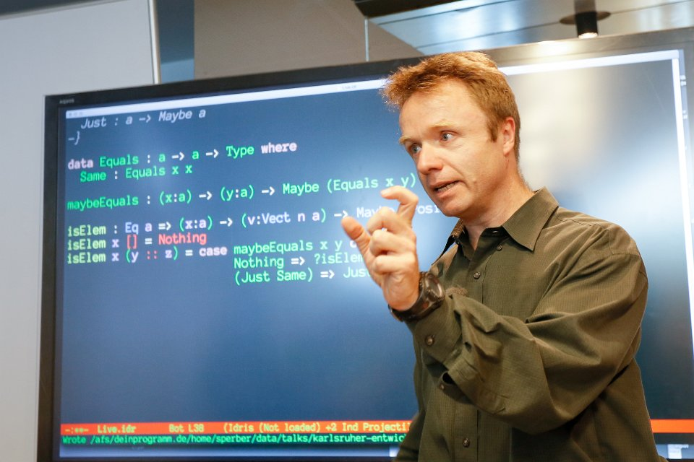




Slide 3
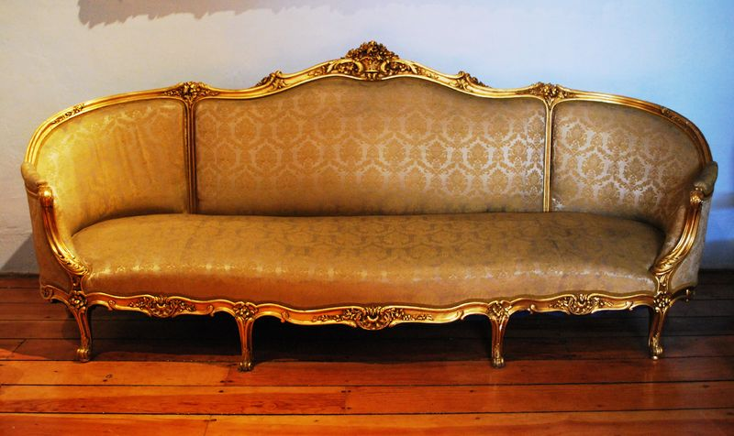
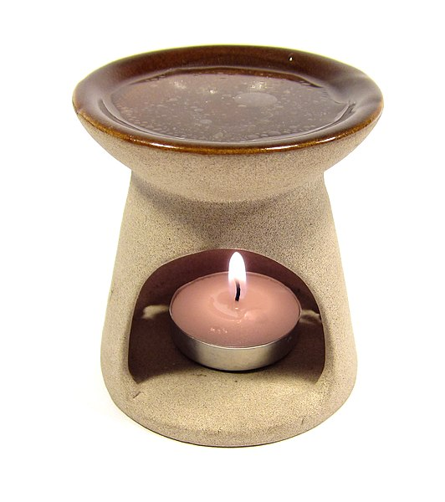
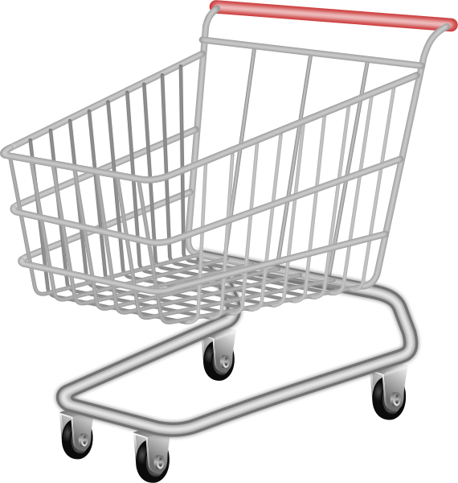
Da Shopping Cart
put articles in cart—always
go to checkout
choose shipping address
no shipping furniture to Packstation
don’t lose input data
Source: Wikimedia (sofa), Wikimedia (candle diffuser)

Slide 4
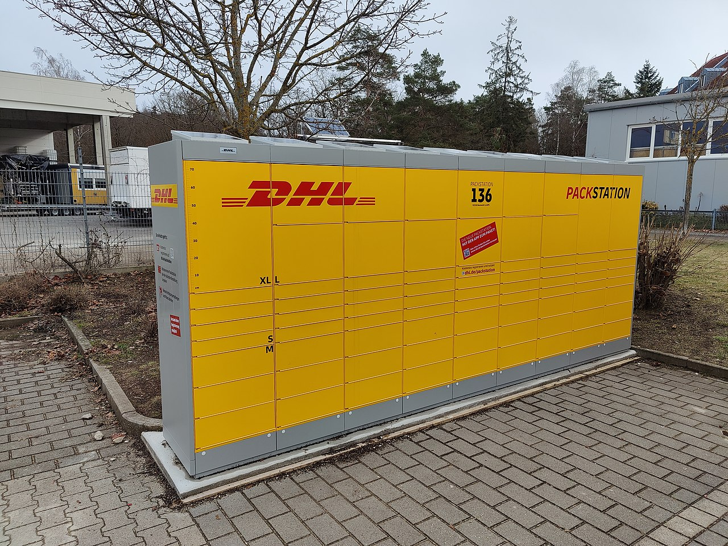
Packstation
Source: Wikipedia

Slide 5
States
Draft Cart
Checkout-Ready Cart
Checked-OutCart

Slide 6
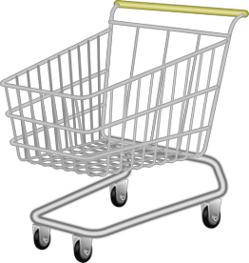
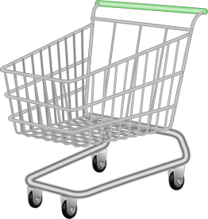
Ubiquitous Language vs. Abstraction
“shopping cart”
“monoid”, “monad”
domain things - DDD ✅, FP 🤷
implicit/emergent domain things 🤼‍♂️ ❓
domain-independent abstractions FP/mathematics ✅

Slide 7


“Before Reuse Comes Use”
simplicity
generality

Slide 8
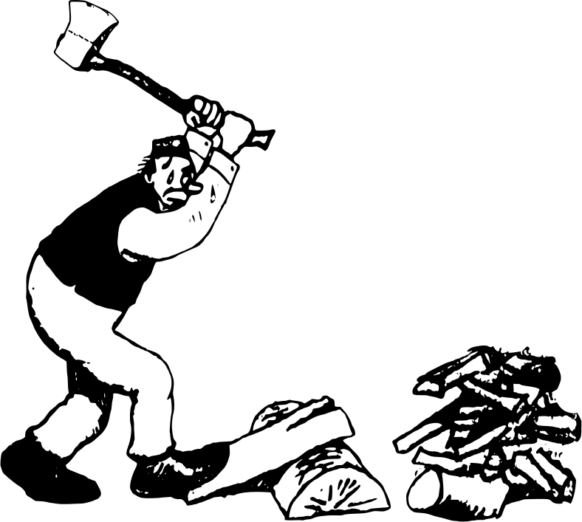
BDD vs. Design Recipes

Slide 9
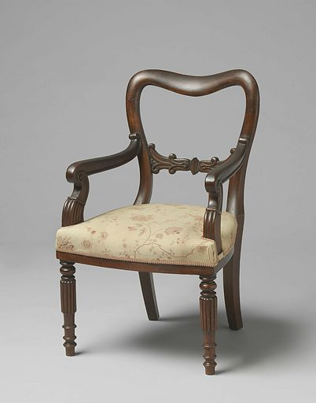
Entities vs. Value Objects vs. Domain
difference well-defined?
good for what?
domain or technology?

Slide 10
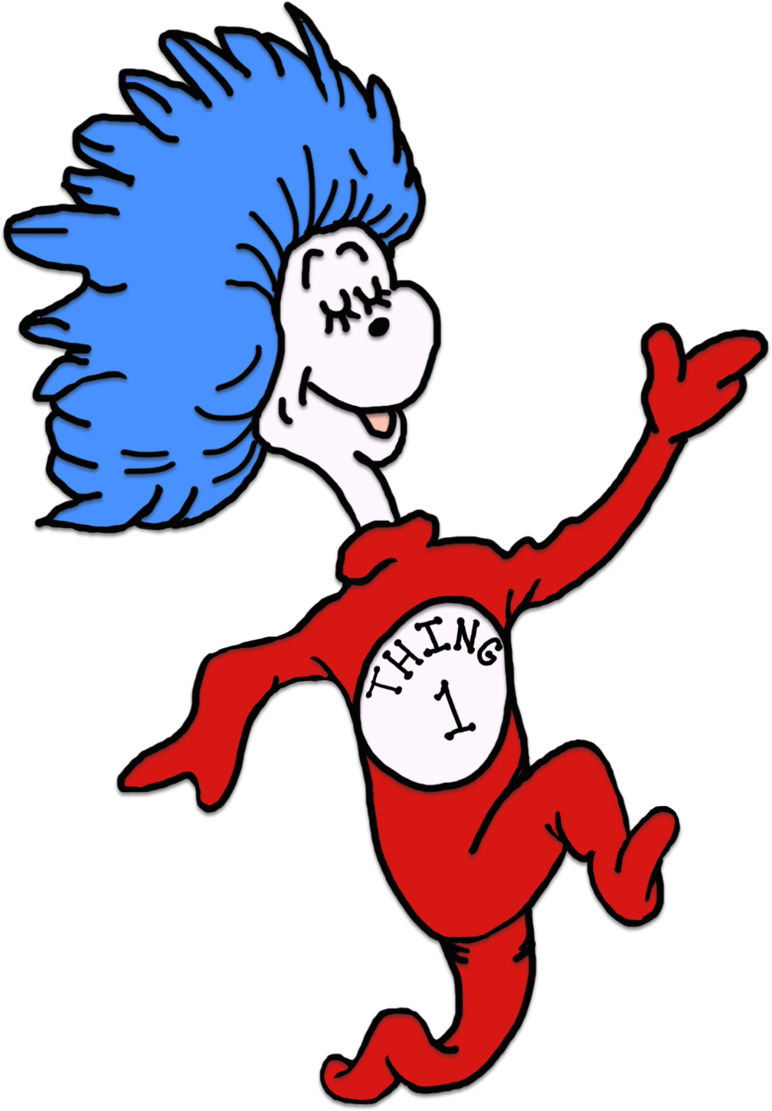
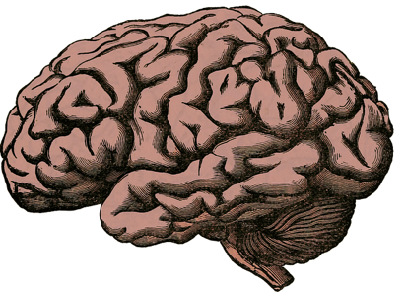

What Is It That We’re Modeling?

Slide 11

... and What About Mutability?
ideology?
pragmatics?
technology?
situational?
2024?

Slide 12
Not Friends, Yet
Domain Storytelling Processes
Context Mapping Ubiquitous Language
BDD Operation Signatures
TDD Test Cases & Functions
Design Recipes Data Analysis
Design Recipes Functions
Abstraction Types

Slide 13


software project development
many different fields
functional programming
training, coaching
iSAQB-accredited Functional Software Architecture
www.active-group.de
funktionale-programmierung.de
Mike Sperber
@sperbsen@discuss.systems
Notes:
nie in OOP sozialisiert

Slide 14
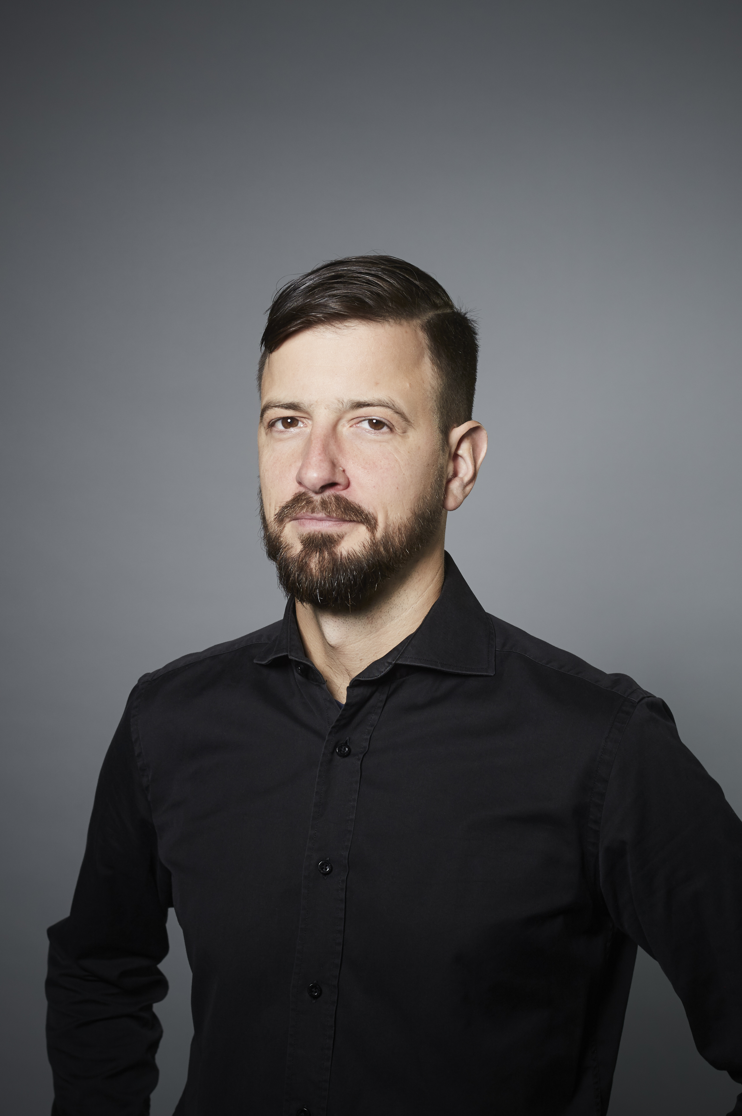
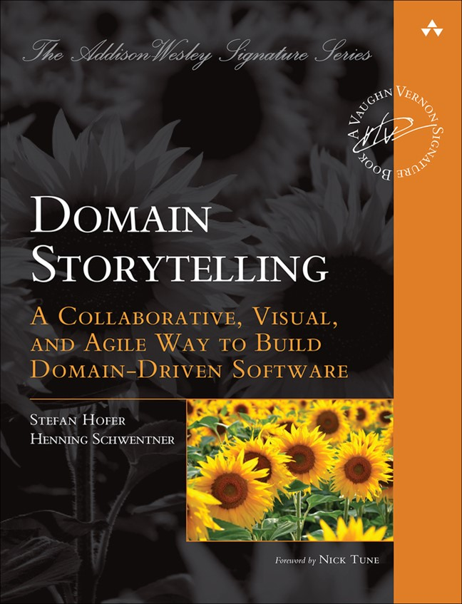
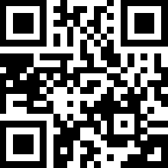
Henning Schwentner
 https://hschwentner.io
 @hschwentner
→ hs@wps.de
Notes:
Book and slides: Homepage

